Slide 1
Principles of the Software Design
Course for Armenian-French University
Areg Melik-Adamyan
Petr Kurapov

Slide 2
Lecture 3
Decomposition

Slide 3
Agenda
Getting to the lower-level decomposition
Functional decomposition
Domain decomposition
Objec-oriented decomposition
Volatility-based decomposition

Slide 4
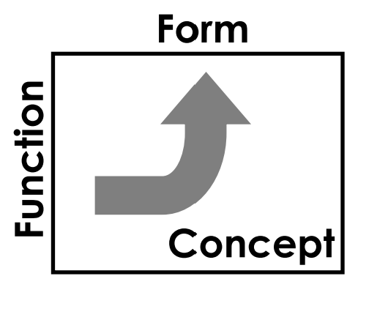
System decomposition
We started to talk about the modules/subsystems
How to transit from Concept to modules?
Some definitions from literature:
“System decomposition begins by decomposing the system into cohesive, well-defined sub-components.” etc…
Most decomposition paradigms suggest breaking down a program into parts to minimize the static dependencies between those parts, and to maximize each part's cohesiveness. Popular decomposition paradigms include the functional, modules, abstract data type, and object-oriented paradigms.
But nobody clearly explain how?

Slide 5
History
Early Structured Programming:
In the 1960s and 70s, structured programming methodologies like "top-down design" promoted the idea of breaking down problems into hierarchical levels, where a complex system was divided into sub-systems, then further subdivided into smaller modules, enabling a systematic approach to software development.
Modular Design:
The concept of modularity, where independent units (modules) with well-defined interfaces could be combined to build larger systems, became a crucial aspect of decomposition. (Codd, Yourdon)
Edsger W. Dijkstra's Influence:
Dijkstra's work on structured programming and his emphasis on "divide and conquer" strategies significantly contributed to the widespread adoption of system decomposition in software design.
Object-Oriented Programming (OOP):
The emergence of OOP further refined decomposition by introducing the concept of "objects," which encapsulate data and behavior, allowing for more intuitive and reusable components within a system.
Data Flow Diagrams (DFDs):
DFDs, a visual representation of data movement within a system, were used to identify functional components and their interactions, aiding in the decomposition process.
Modern Approaches:
Today, system decomposition is still a vital principle in software engineering, with advanced techniques like microservices architecture, where systems are broken down into small, independently deployable services, allowing for greater scalability and flexibility.

Slide 6
Functional decomposition
A decomposition into modules based on requested functionality.
The “easiest” form of decomposition; comes naturally.
E.g., list all the required functionalities and build components addressing each.
A house architecture
Cooking
Bathing
Entertaining
Paying bills
Eating
Cleaning
Reading
Fixing
Programming
Sleeping
…

Slide 7
Functional decomposition: problems
Modules and requirements coupling.
Modules reflect requirements; when requirements change modules need to change accordingly.
A change to “cooking” functionality affects other modules.
A house architecture
Cooking
Bathing
Entertaining
Paying bills
Eating
Cleaning
Reading
Fixing
Programming
Sleeping
…

Slide 8
Functional decomposition: problems
Explosion of components number.
Large number of functions in modern systems; common functionality duplication with customization.
E.g., “eating” and “programming” duplicate a “table” functionality

Slide 9
Functional decomposition: problems
System hierarchy flattening.
Separate functions need to be stitched together by an orchestrating module with customization; dependencies creep into the orchestrating module.
Parameters setting, exception handling, customization, etc.
Orchestrator 1
Orchestrator 2
Orchestrator
Extra logic
Extra logic
Parsing
Processing
Printing
Parsing
Processing
Printing
Extra logic
Extra logic
Extra logic
Bloated orchestrator – aware of implementation details of all used functions. High cyclomatic complexity.
Bloated functions – breaking abstractions above (exceptions) and below (parameters).

Slide 10



Requirements as solutions
Concept!!!
Requirements are often passed in a form of functionally decomposed modules that solve the problem (e.g., cooking).
The real requirement is not obvious.
Failure to find the real requirement creates a zoo of functionally decomposed modules to address different aspects of it.
…
Unpack solutions until the actual requirement is revealed

Slide 11
Domain decomposition
A decomposition into modules based on functionality domain.
Disguised functional decomposition.
A house architecture
Kitchen
Bedroom 1
Living room
Bedroom 2
Attic
Garage

Slide 12
Domain decomposition: problems
Domains reimplement functionality.
E.g., the two bedrooms implement “sleeping” functionality.
Module duplication – higher support/change complexity.
A house architecture
Kitchen
Bedroom 1
Living room
Bedroom 2
Attic
Garage

Slide 13







Domain decomposition: problems
Building domain structure requires domain rebuilding during functionality extension.
E.g., building a domain house.
Milestone 2.0: build a living room.
Demolish outer walls
Unbolt kitchen from foundation
Disconnect from power supply
Disconnect from water supply
Lift the kitchen with hydraulic jacks
…
Kitchen
Cooking
Milestone 1.0 done!
Code shipped; customers are happy!

Slide 14
Object-Oriented Decomposition
Identify the System Requirements
Gather and analyze functional and non-functional requirements.
Determine the Key Objects
Extract entities and concepts relevant to the problem domain.
Define Class Hierarchies
Establish superclass and subclass relationships.
Utilize inheritance where appropriate.
Assign Responsibilities
Determine what each class should know and do.
Apply the Single Responsibility Principle.
Establish Relationships Between Classes
Define associations, aggregations, and compositions.
Model interactions and dependencies.
Design Class Interfaces
Specify public methods for object interaction.
Ensure encapsulation by keeping internal data private.

Slide 15
Drawbacks of OOD
1. Complexity in Large Systems
Overhead in class hierarchy design: As systems grow in size, designing an efficient and intuitive class hierarchy becomes challenging. Poor design choices can lead to overly complex systems with tightly coupled classes.
Deep inheritance hierarchies: Deep inheritance chains may introduce complexity and make it harder to understand and debug the system.
2. Performance Overhead
Abstraction penalty: Object-oriented systems often introduce multiple layers of abstraction, which can slow down performance, especially when dealing with fine-grained objects or large numbers of interactions.
Memory usage: Objects in OOP tend to use more memory due to additional metadata and object structures, which can impact performance in memory-constrained environments.
3. Difficulty in Mapping Real-World Problems
Not all problems are naturally object-oriented: Some real-world problems may be better suited to a procedural or functional approach. Forcing an object-oriented structure onto problems like mathematical calculations or low-level system operations can lead to unnecessarily convoluted designs.
4. Excessive Generalization
Over-engineering: Object-oriented design can sometimes lead to over-generalization, where developers create too many classes and abstractions that are unnecessary for the current use case but add complexity.
Premature design: Developers may design systems for reusability or extensibility that is not needed, leading to unnecessary layers of abstraction.
5. Tight Coupling
Dependence between classes: Inappropriately designed object relationships may lead to tight coupling, where changes to one class force changes to others, breaking encapsulation and making the system difficult to modify and extend.
6. Steep Learning Curve
OOP concepts: Beginners may find it difficult to grasp core OOP principles like inheritance, polymorphism, and abstraction, leading to poorly designed systems or misuse of object-oriented features.
Class responsibility distribution: Deciding the right balance of responsibility for classes requires a strong understanding of design principles like Single Responsibility Principle (SRP), which may not be intuitive for new developers.
7. Testing and Debugging Challenges
Hidden behavior: Due to encapsulation and polymorphism, tracking down the source of bugs can become more difficult, as behavior may be hidden behind layers of abstraction or dynamic dispatch.
Mocking dependencies: Unit testing object-oriented systems often requires setting up mock objects for dependencies, which can increase test complexity and reduce maintainability.
8. Inflexibility Due to Inheritance
Inheritance rigidity: Inheritance creates tight coupling between parent and child classes. Changes in the base class can force changes in subclasses, and misused inheritance may lead to fragile class structures that are hard to modify.
Favoring composition over inheritance: Over-reliance on inheritance can sometimes limit flexibility. It’s often more effective to use composition, but this is not always recognized in early OOP designs.
9. Concurrency and Parallelism Issues
Concurrency difficulties: Objects encapsulate both data and behavior, making it harder to manage state in a multithreaded or concurrent environment, where shared state among objects can lead to issues like race conditions or deadlocks.

Slide 16
Volatility-based decomposition
A decomposition into modules based on areas of potential change encapsulation.
E.g. high-volatility in power
Different sources, connectivity, and a power socket as interface.
Changes are contained in a single module – no side effects outside module boundary.
On the criteria to be used in decomposing systems into modules
Can be found on the course website.
“decomposition was made using ‘information hiding’ as a criterion”.

Slide 17
Volatility-based decomposition
Volatility is not self-evident.
Volatility is identified during requirements analysis process.
Change and volatility are different.
Change produce conditional logic.
Volatility requires encapsulation.

Slide 18
Volatility-based decomposition
Volatility “happens” at independent axes.
E.g., different customers have different expectations.
Can I reuse the module for a different customer?
Volatilities: structure, neighbors, city, …
E.g., the same customer changes requirements over time.
Can I use the module for this customer forever?
Volatilities: furniture, occupants, appliances, utilities, …
The required behavior is accomplished by an interaction between encapsulated areas of volatility.

Slide 19
Identifying volatility
What are volatility areas for Git?

Slide 20
Identifying volatility
What are volatility areas for Git?
User volatility. Users of basic functionality to track their records. Large-scale enterprises building software projects. Language preferences.
Client volatility. Automation applications (e.g., CI/CD). Command line vs high-level GUI tools.
Operating environment volatility. Operating system, filesystem, memory capacity, distributed storage, compression libraries, etc.
Content volatility. File types, sizes.
Connection/synchronization volatility. Multiple asynchronous commits from different users.
Security. Protocol version. Local/remote.
…

Slide 21
System decomposition
Based on volatility areas; not a one-to-one transition.
Single component encapsulating more than one area (e.g., fsmonitor).
Some areas expressed through not a component but an operational concept (e.g., environment + object access for commit amending).
Accessing blob objects make changing file type easy to accommodate.
Command line
GUI App
Security
Environment
Fsmonitor
…
Object access
Object storage

Slide 22
Just-enough SW architecture
Rare changes should not be encapsulated.
Speculative design increases system complexity.

Slide 23
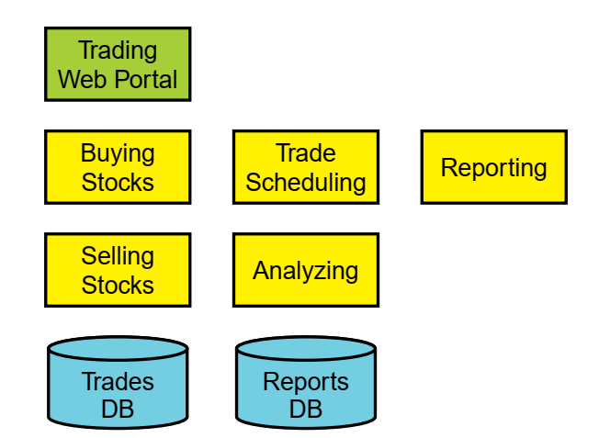
EXAMPLE: FUNCTIONAL TRADING SYSTEM
The system should enable in-house traders to:
Buy and sell stocks
Schedule trades
Issue reports
Analyze the trades
The users of the system utilize a browser to connect to the system and manage connected sessions, completing a form and submitting the request.
After a trade, report, or analysis request, the system sends an email to the users confirming their request or containing the results.
The data should be stored in a local database.
Functional decomposition

Slide 24
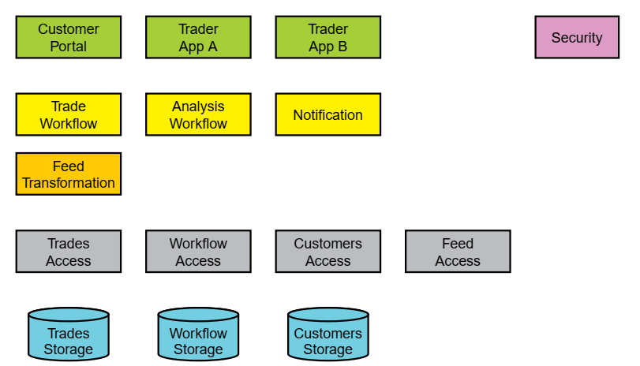
Example: Volatility Based Trading System
User volatility
Client application volatility
Security volatility
Notification volatility
Storage volatility
Connection and synchronization volatility
…

Slide 25
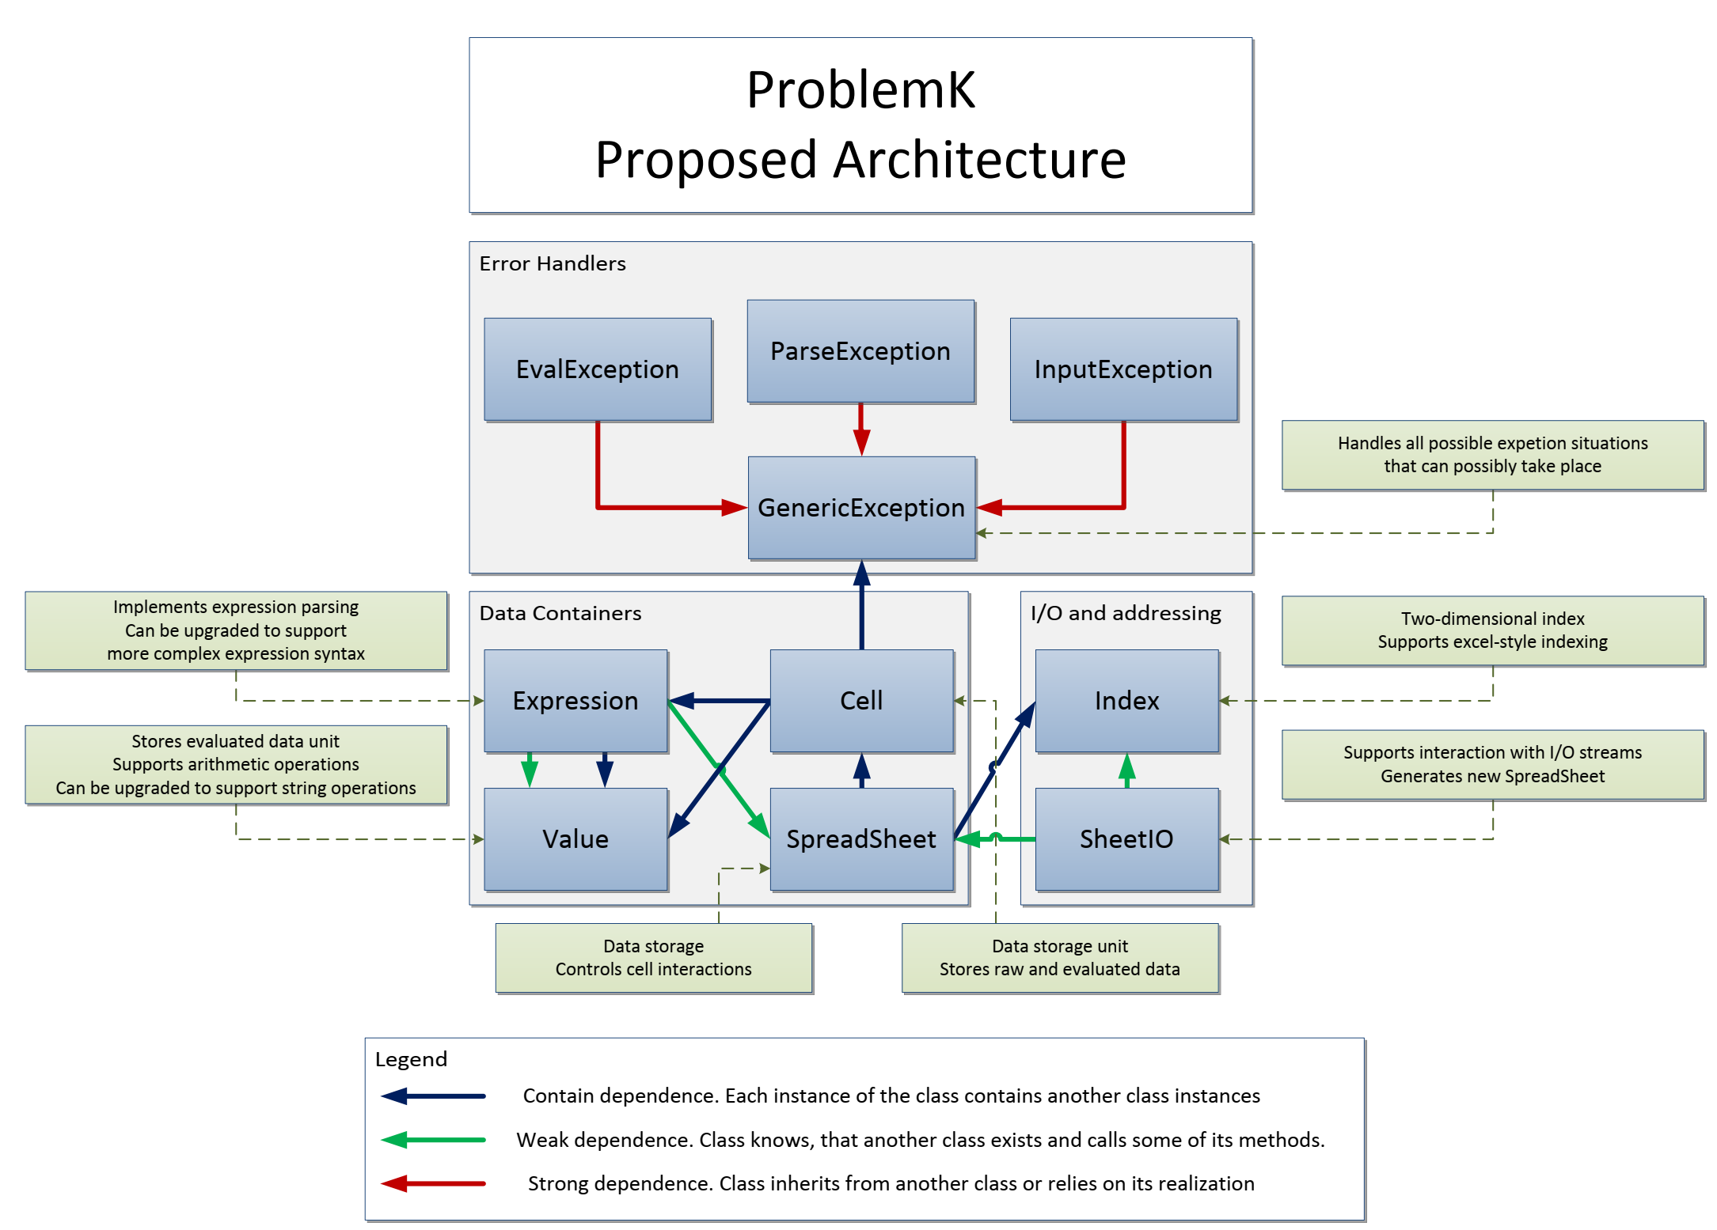
Problem K – A Solution
Good or Bad?
What type of decomposition is this?
What changes would you propose?

Slide 26
Homework
Continue with Problem K armed with the new knowledge.

